Slide 1

Topic 1: The Bar and the Neighbourhood
Chapter 1: Introducing Amarantus and his neighbourhood

Slide 2

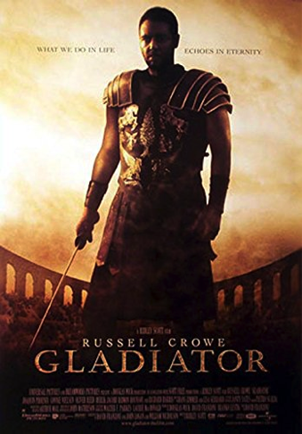
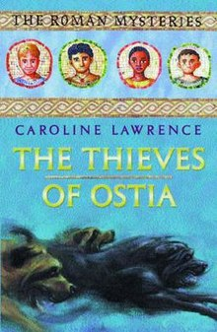
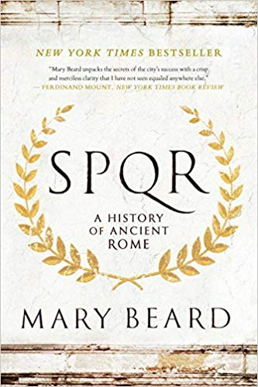
How will these stories told about
the Romans differ and why?
Hollywood film
Children’s fiction
Non-fiction history

Slide 3
Which of these will tell the best stories
about the Romans?
Hollywood film
Children’s fiction
Non-fiction history

Slide 4


Professor Wallace-Hadrill is an historian and Dr Hay is an archaeologist.
They have been working on an archaeological excavation in Pompeii and have found
some exciting evidence which tells us about the lives of the people who lived there.
Their work led them to ask two questions that we will be investigating during this unit.
What stories can we tell using this evidence?
What stories should we tell?
Professor Andrew Wallace-Hadrill
Dr Sophie Hay

Slide 5
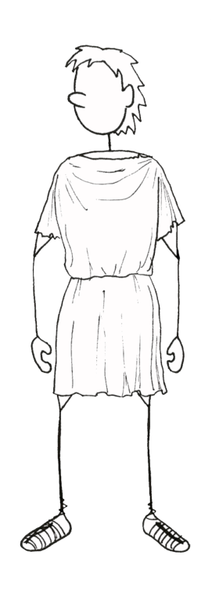

They asked author Caroline Lawrence to look at their evidence and see if she could write a story using it; she was very excited!
Caroline is a classicist. She has studied the Romans and can understand their language, Latin. She is always very careful to base her stories on good evidence and to try and reflect what we think Roman life may have been like.
We will be reading her story
‘Amarantus and his neighbourhood’
in our lessons. She also has a favour
to ask you…
A production company has decided to create a TV series based on my story, but eheu! (Latin for ‘oh no!’) they need an extra episode to fit in with their scheduling and I’m so busy I don’t have time to write it!
Can you help me out please? I need you to draft an extra episode of the story of Amarantus!

Slide 6




Don’t worry though…
Dr Sophie
and Caroline
… will be there throughout to help you!

Slide 7
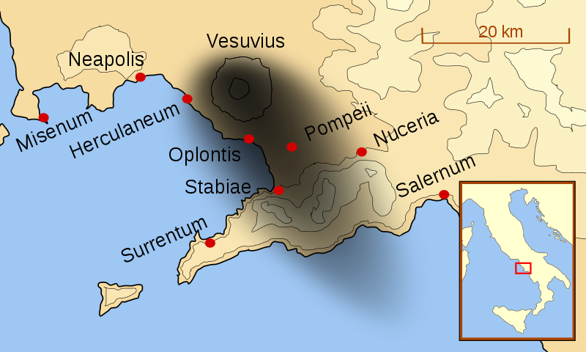
Pompeii, what do we know?
A port city of around 15,000 inhabitants in the Bay of Naples, close to Mt Vesuvius.
There was a violent earthquake in AD 63, but before that Vesuvius had been dormant since the 8th Century BC.
In August AD 79, Mount Vesuvius erupted, burying the city of Pompeii —and many of its citizens—beneath tons of volcanic ash and debris.
Since its rediscovery in the mid-18th century, the site has been under constant excavation; the longest continually excavated site in the world.
https://commons.wikimedia.org/wiki/File:Mt_Vesuvius_79_AD_eruption-la.svg

Slide 8
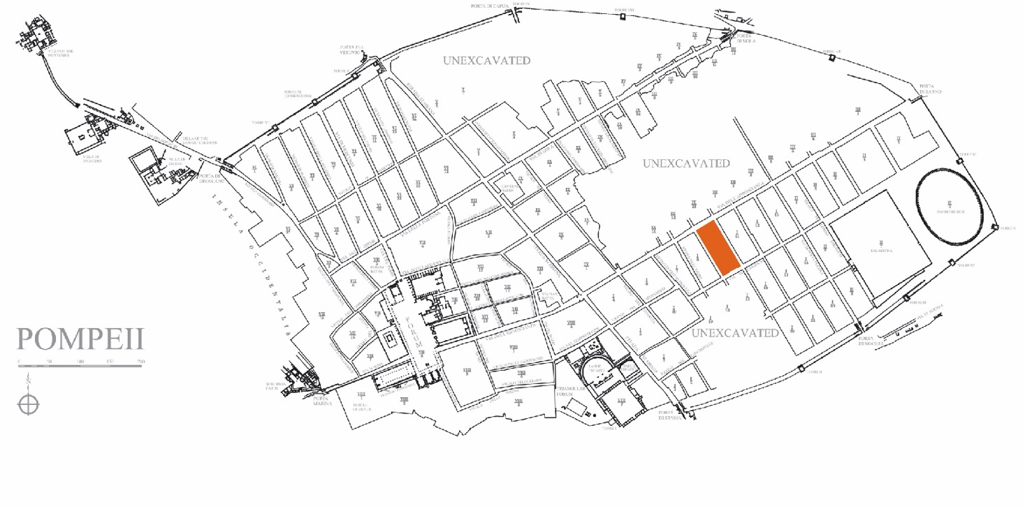
Region I, Insula 9 (I.9)

Slide 9
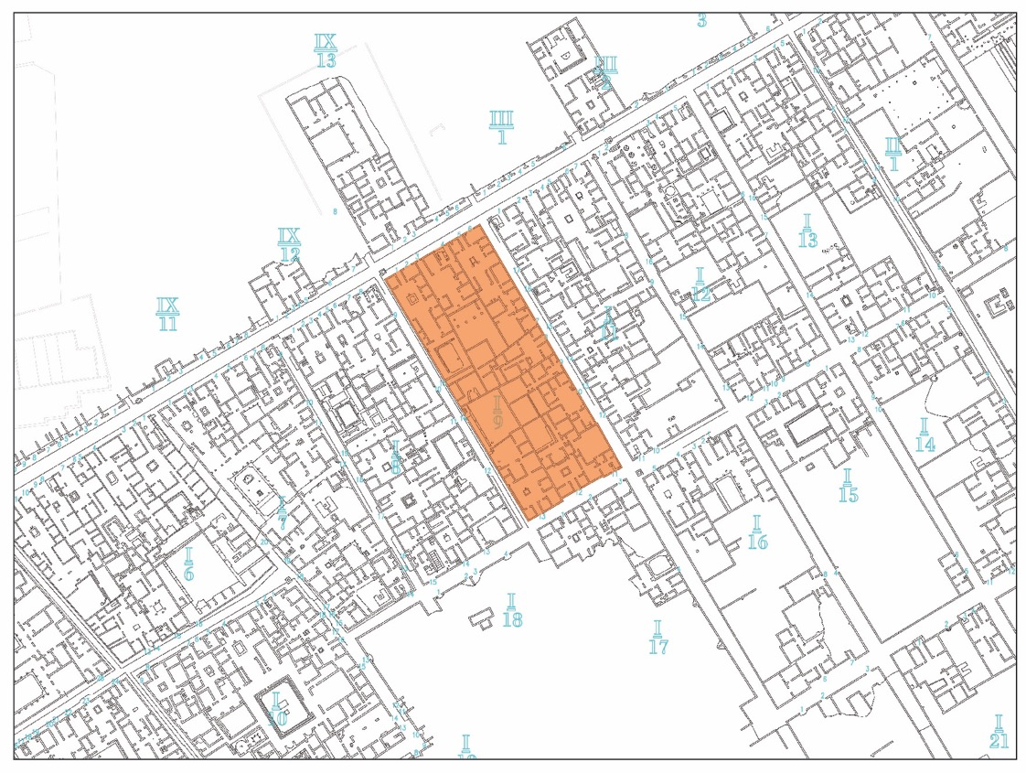
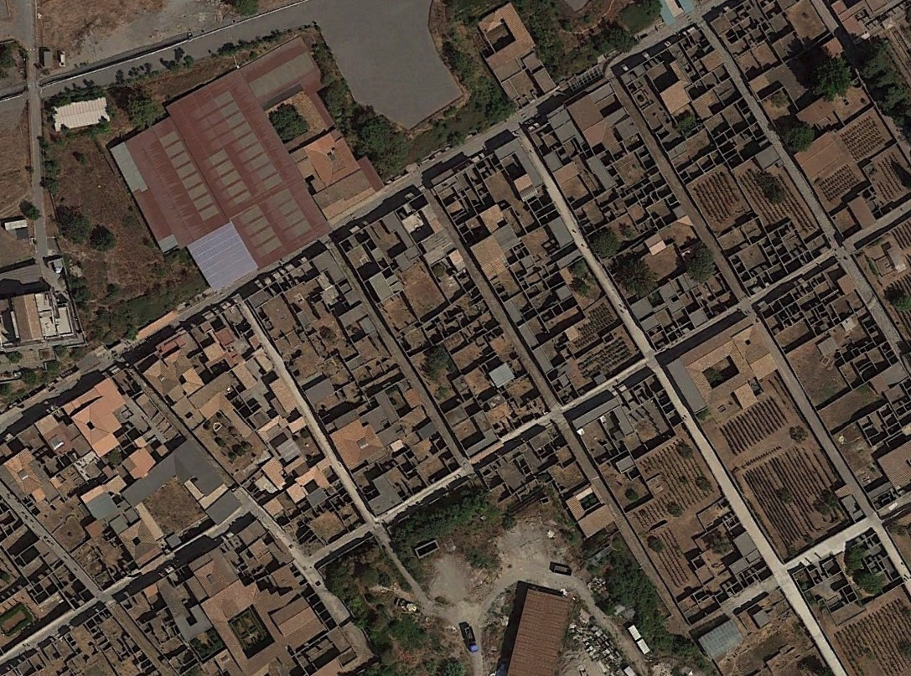
Region I, Insula 9 (I.9)
Notes:
Close up of insula.
Seen on Google maps: can see excavated and unexcavated areas.

Slide 10
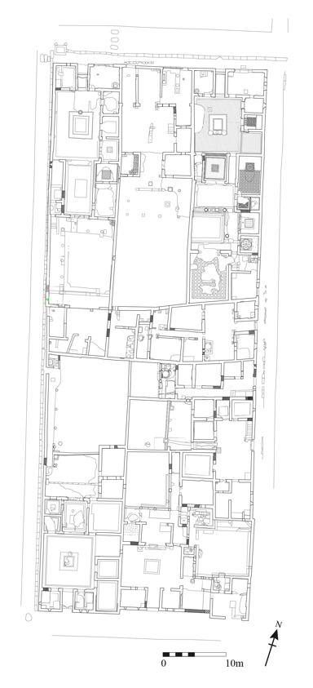
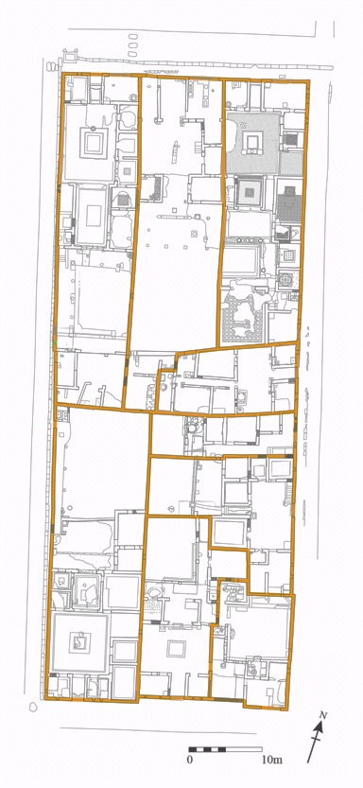
Region I, Insula 9 (I.9)
1.9.3
Successus
House outlines
1.9.1
Beautiful Impluvium
1.9.5
Fruit Orchard
1.9.8
House 8
1.9.9
Painter’s workshop
1.9.13
Ceres
1.9.10
House 10
1.9.12
?????
1.9.11
?????

Slide 11
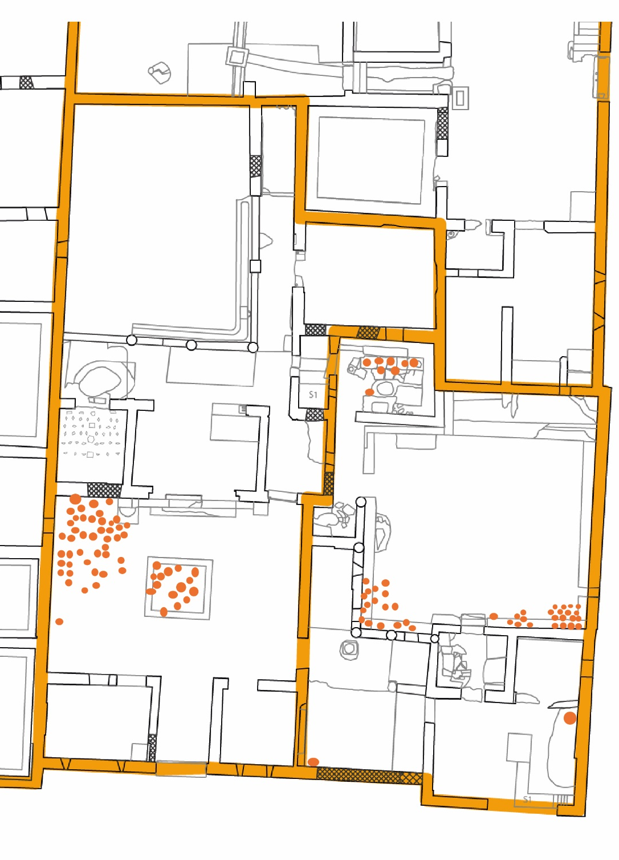
Rooms in Roman Houses
Bedroom (cubiculum)
Main room (atrium)
Study (tablinum)
Dining room (triclinium)
Kitchen (culina)
Toilet
Entrance hall
Garden

Slide 12
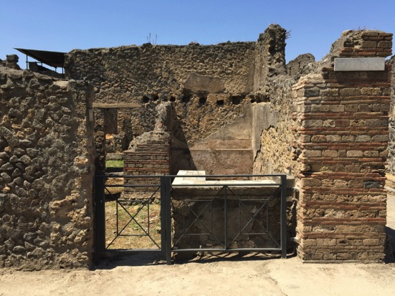
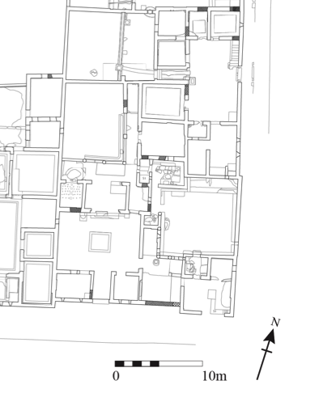
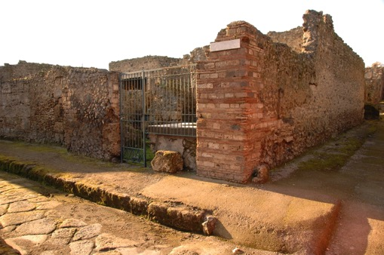
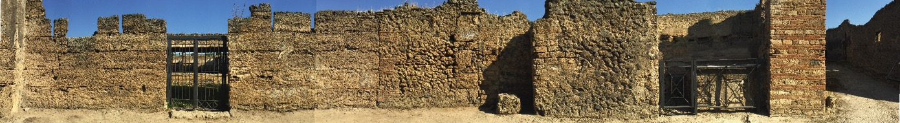
Houses 11 and 12: What claims can we make?

Slide 13
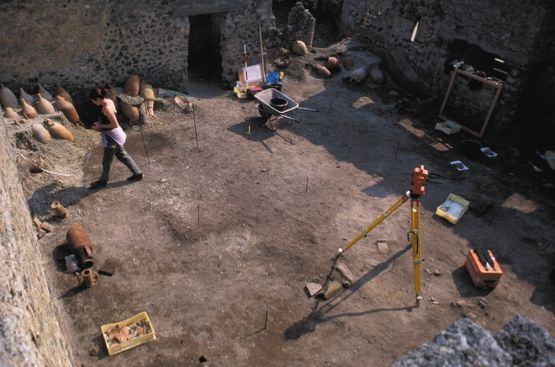
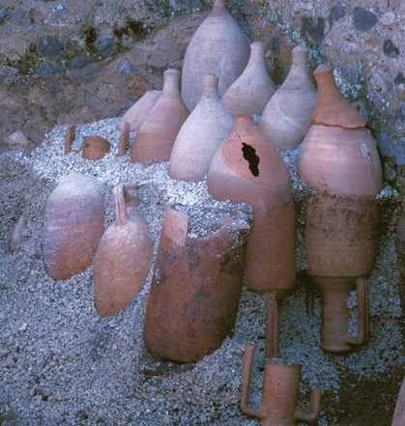
House 11: What type of building is this?
Many wine jars (amphorae) were found in House 11; mostly stored upside down, so we assume they were empty!

Slide 14
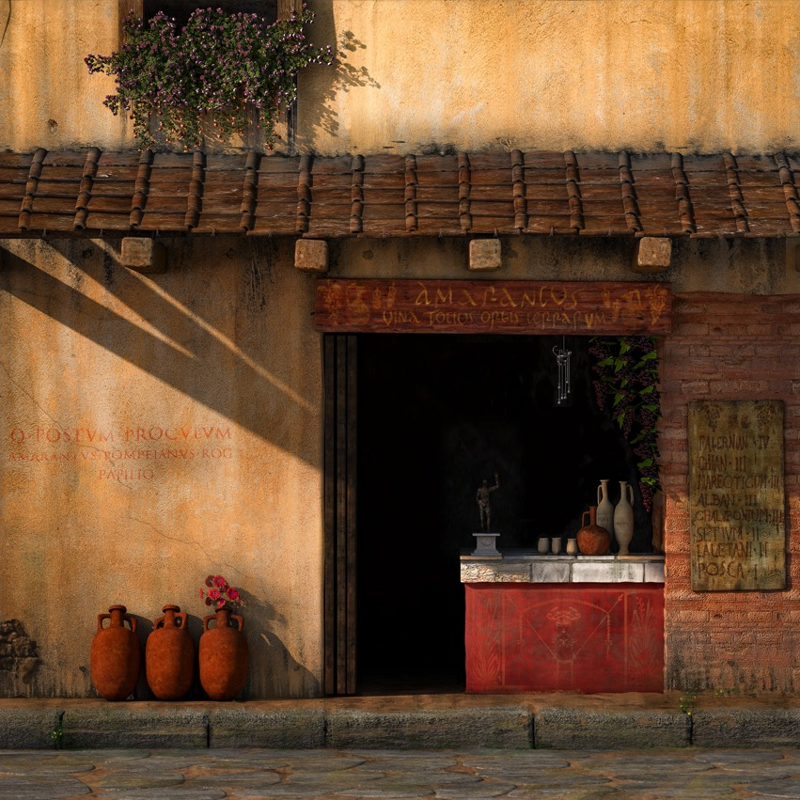


Slide 15
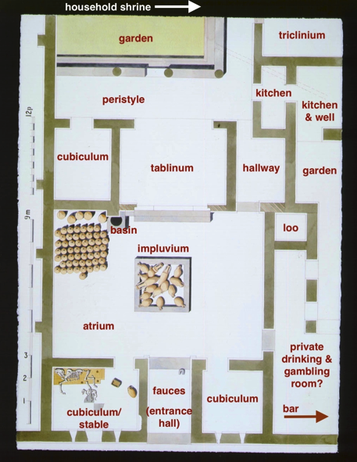
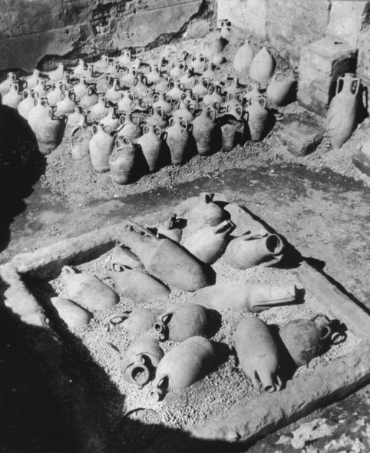
House 12: Who would live in a house like this?

Slide 16
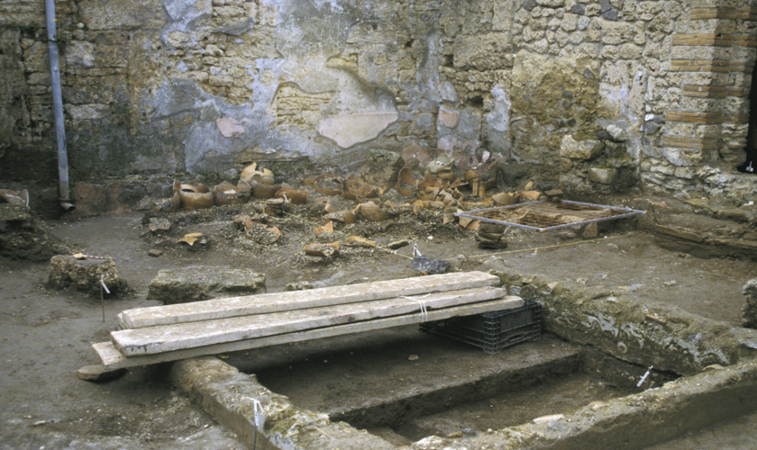
House 12: Who would live in a house like this?
An impluvium is a shallow pool in the main room of a Roman house that collected rainwater underneath a gap in the roof.
They were usually highly decorated and could be seen from the street through the doorway.
This impluvium is different - it’s a fake! There seems to be no drainage system and there’s no evidence of a roof here.
Why would someone put a fake impluvium in their house? What does it tell about the person who lived here?

Slide 17
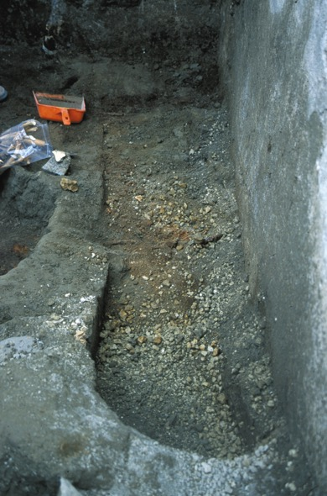
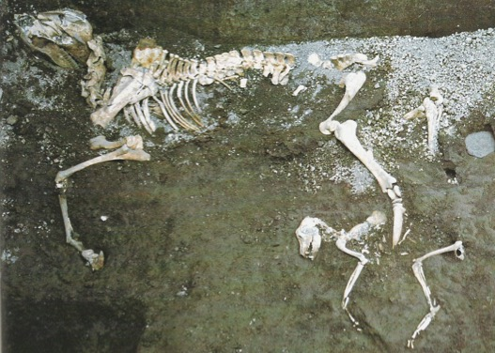
House 12: Who would live in a house like this?

Slide 18
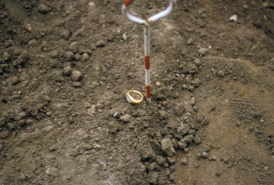
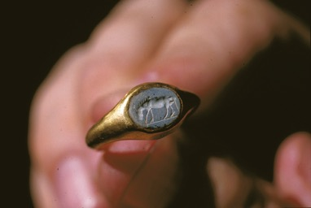
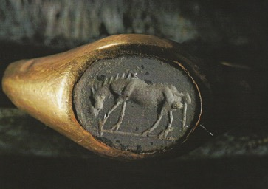
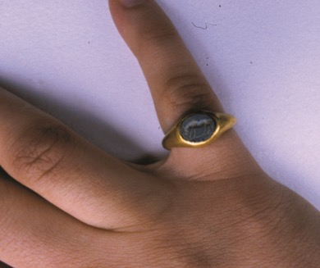
House 12: Who would live in a house like this?

Slide 19

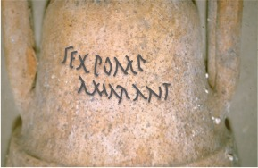
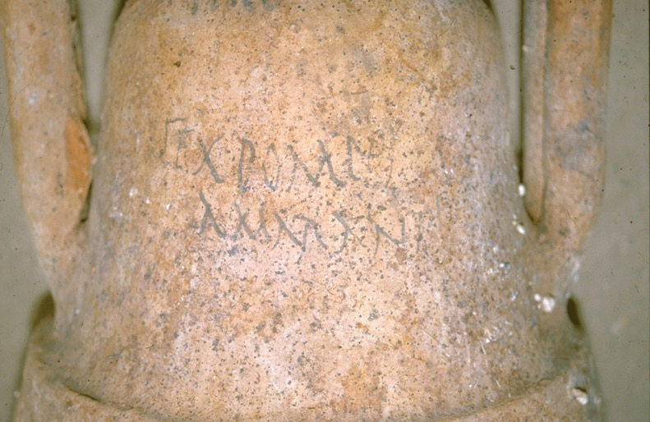
The amphorae – taking a closer look
Tituli Picti:
Sextus Pompeius Amarantus
Amarantus is a non-Roman slave name, BUT the three name format implies that he was a freedman whose owner (Sextus Pompeius) gave him his names when he freed Amarantus.

Slide 20
What have we found out so far?
House 11 was a Bar and was connected to House 12
The business spilled over into the residential area
They had a fake impluvium
And a fondness for donkeys
We know the name of the owner…
…AND his probable status as a freedman

Slide 21
Grafitti – Roman Social Media
A lot of the evidence we’ll be examining in this module will be graffiti;
marks, images or writing scratched into surfaces all over Pompeii.
Over 11,000 examples of graffiti have been uncovered in Pompeii.
Although many have been destroyed by the weather etc., archaeologists have been recording them since the 1800s, so we have a really good record of what was there.
The Romans appear to have used graffiti a bit like we use Twitter or Facebook – a way to let other people know what was on their mind – so these (often rather rude!) scribblings give us a better understanding of everyday life.

Slide 22

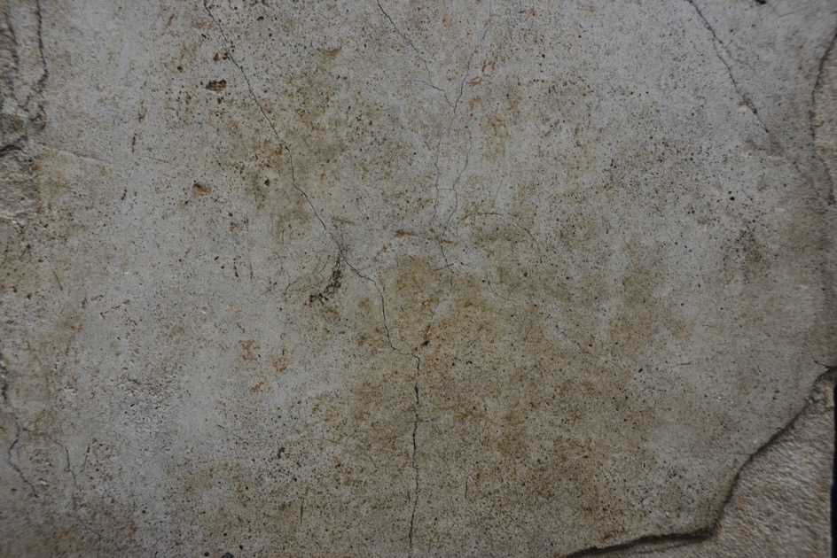

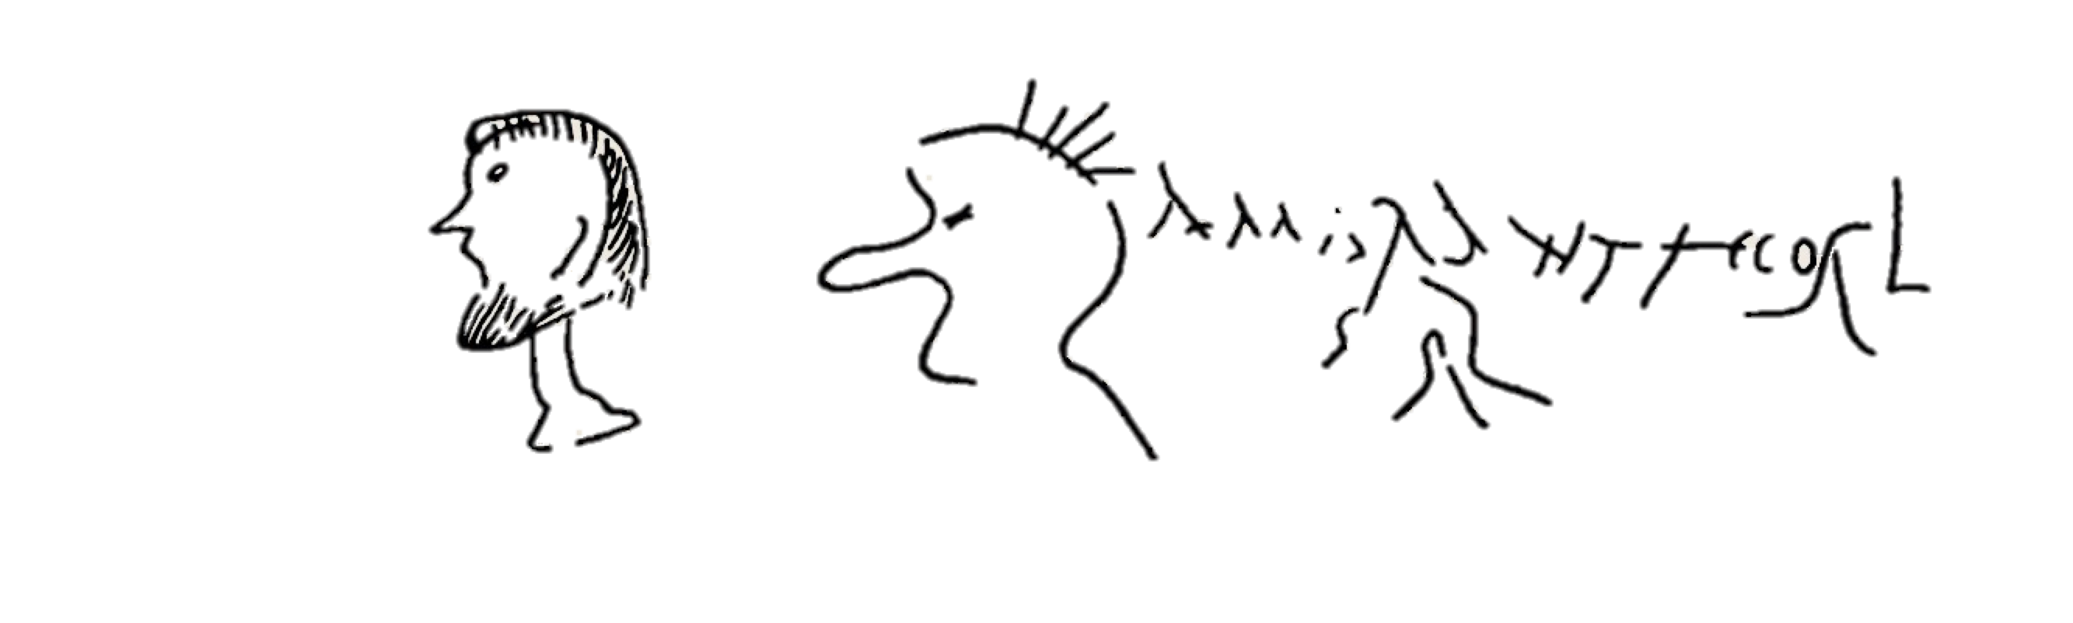
Grafitti – Roman Social Media
1.9.5 House of the Fruit Orchard

Slide 23
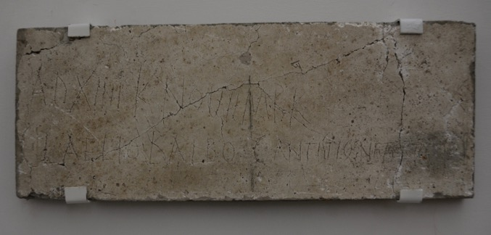




Grafitti – Roman Social Media
‘14th (XIIII) day before the kalends (1st) November in the year when Balbus and Vetus were consuls’: 19th October 6 BCE

Slide 24
What kind of people
do you think
lived and worked
in Houses 11 and 12?

